Slide 1

Predictive Analytics
8.1 Heart disease detection
Notes:
---
Welcome to our Data Analysis with Python tutorial.
My name is Santiago, and I'm an instructor at RMOTR.com, an online Data Science academy.
This tutorial is the result of a joint effort by RMOTR and freecodecamp and it's totally free. It includes Slides, Jupyter Notebooks and coding exercises.

Slide 2

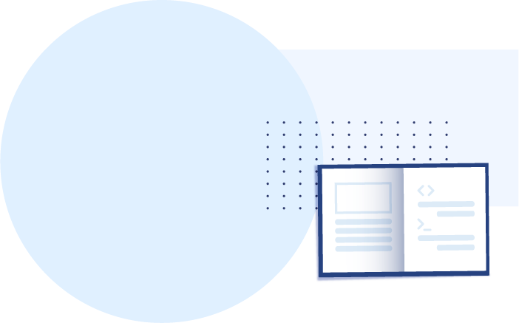
About this project
Objectives
Problem statement
Research objectives
Predictive models
Accuracy
Data Cleaning, Transformation
Confusion Matrix
Future expansions
Data Analysis Tools
Q & A

Slide 3
Objectives
• This project allows to integrate and apply the knowledge, skills and concepts that you have acquired throughout the academic journey.
• It allows to demonstrate the understanding of key concepts, methodologies and best practices.
• It helps in professional development by fostering skills such as time management, teamwork and problem solving.
Data source Parkway Pantai
70,000 records
4 countries

Slide 4
Problem statement
Heart disease is a leading cause of mortality worldwide. Early detection and accurate prediction of heart disease can significantly improve patient outcomes by enabling timely intervention and preventive measures. The objective of this project is to develop a machine learning model that can effectively predict the presence or absence of heart disease based on various medical and lifestyle factors.

Slide 5
Research objectives
1. Identify possible causes of getting heart disease.
2. Identify segments that have high chance of getting heart disease.
3. Create models to predict heart disease.
4. Preventive measures to get heart disease.
5. Detection of heart disease.

Slide 6
Predictive models
3.Create models to predict heart disease.
Linear Logistic Regression
Linear Support Vector Machine
K Nearest Neighbours
Naive Bayes
Decision Tree
Random Forest

Slide 7
Accuracy
# | Model | 70% train Accuracy | 80% train Accuracy | 90% train Accuracy |  | One-Hot Encoding Accuracy |  | One-Hot Encoding SG Accuracy |  | Label, One-Hot Accuracy |  | 4 features Accuracy
1 | Logistic Regression | 72.43 | 72.41 | 72.26 |  | 72.49 |  | 73.26 |  | 72.26 |  | 71.46
2 | SVM | 51.42 | 57.26 | 49.11 |  | 50.90 |  | 45.45 |  | 32.29 |  | 50.67
3 | K Neighbors | 71.11 | 70.99 | 71.23 |  | 70.96 |  | 70.80 |  | 72.10 |  | 70.64
 | K Neighbors Max | 71.20 | 71.28 | 71.53 |  | 71.20 |  | 71.35 |  | 72.26 |  | 70.88
4 | Categorical NB | 72.35 | 72.26 | 72.17 |  | 72.40 |  | 72.88 |  | 72.51 |  | 70.65
 | Gaussian NB | 69.66 | 69.68 | 69.80 |  | 69.64 |  | 70.86 |  | 69.38 |  | 69.52
5 | Decision Tree | 72.32 | 72.56 | 72.67 |  | 72.32 |  | 72.92 |  | 72.80 |  | 71.70
 | Decision Tree Max | 72.58 | 72.59 | 72.67 |  | 72.58 |  | 73.03 |  | 72.98 |  | 71.72
6 | Random Forest | 72.60 | 72.59 | 72.50 |  | 72.57 |  | 73.16 |  | 73.05 |  | 71.10
 | Random Forest Max | 72.70 | 72.76 | 72.64 |  | 72.73 |  | 73.31 |  | 73.16 |  | 71.13

Slide 8
Insights
4 Main features: age_group, ap_hi, ap_lo, cholesterol. 71% accuracy
Age group getting heart disease
  >= 30 - 24.3%
  >= 40 - 38.0%
  >= 50 - 51.6%
  >= 60 - 67.0%
Blood Pressure heart disease when ap_hi > 130, ap_lo > 90
Cholesterol
  1 - 44%
  2 - 60.2%
  3 - 76.5%
No significance of heart disease by country, occupation, gender, active, alco, gluc, smoke

Slide 9
Data Cleaning, Transformation
1. gender 1 = Male 2 = Female
2. Blood pressure restricts to the following range.
ap_hi 59 to 201 Replace with min (59, 40) or max value (201).
ap_lo 40 to 201 The other fields can still be used.
3. age_group = age / 3650, 10 years bin
4. added field pca = 0.5479*active + 0.2249*age_group + 0.1570*alco + …
5. Label encoding
6. One-hot encoding
7. Z-score normalization, height, weight

Slide 10
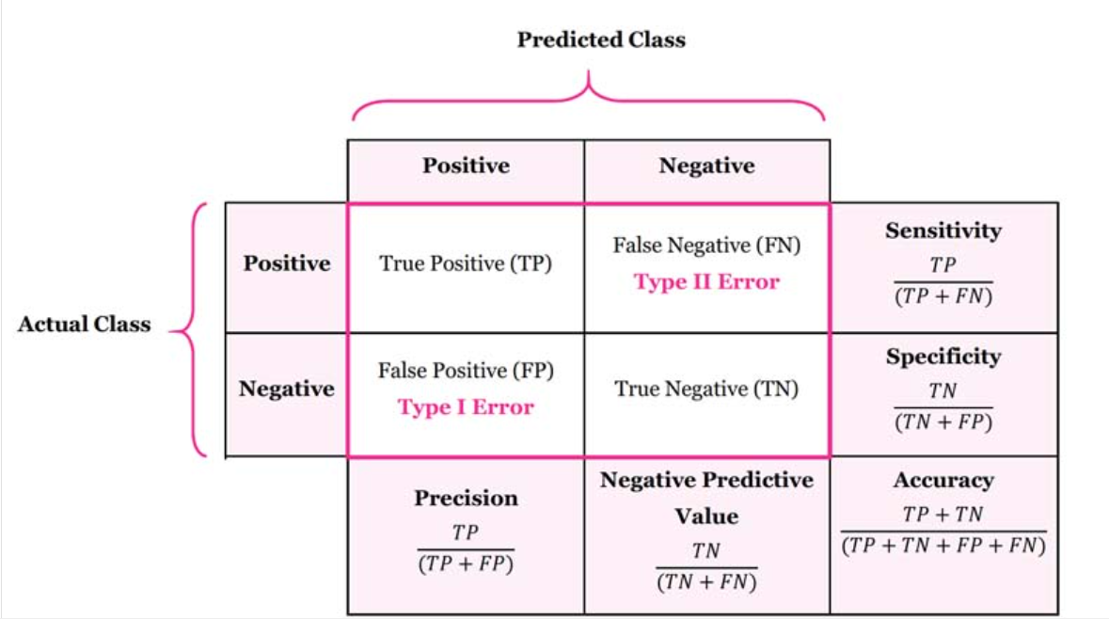
Confusion Matrix
Accuracy, precision, recall

Slide 11
Model
Deployment and Integration
Scalability and Adaptability - SQL
Inner Join
Left Outer Join
Right Outer Join
Full Outer Join
Model Monitoring and Maintenance
Avoid overfitting

Slide 12
Future expansions
Enhance features
physical health
mental health
nutrition
lifestyle
Use ML packages TensorFlow, PyTorch
Commercial ML packages
Computing power

Slide 13
Data Analysis Tools

Slide 14
PYTHON ECOSYSTEM:
The libraries we use...
pandas: The cornerstone of our Data Analysis job with Python
numpy: The numeric library that serves as the foundation of all calculations in Python.
matplotlib: The foundational library for visualizations. Other libraries we’ll use will be built on top of matplotlib.
seaborn: A statistical visualization tool built on top of matplotlib.
statsmodels: A library with many advanced statistical functions.
scipy: Advanced scientific computing, including functions for optimization, linear algebra, image processing and much more.
scikit-learn: The most popular machine learning library for Python (not deep learning)
joblib: Save and load model
Data Transform
from sklearn.preprocessing import StandardScaler
from sklearn.preprocessing import LabelEncoder

Slide 15
PYTHON ECOSYSTEM:
The libraries we use...
Models
from sklearn.linear_model import LogisticRegression
from sklearn.neighbors import KNeighborsClassifier
from sklearn.svm import SVC
from sklearn.naive_bayes import CategoricalNB
from sklearn.naive_bayes import GaussianNB
from sklearn.tree import DecisionTreeClassifier
from sklearn.ensemble import RandomForestClassifier
Accuracy
from sklearn.metrics import confusion_matrix
from sklearn.metrics import classification_report
from sklearn.metrics import accuracy_score

Slide 16
Q & A
Thank you
Notes:
Let’s explore the Python and PyData ecosystem. All the tools and libraries that we’ll be using.

